Slide 1
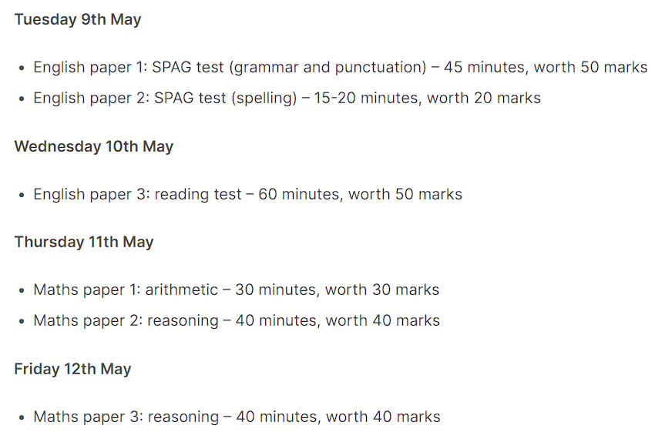
Year 6 SATS 2023 Standard Assessment Tests
Presentation for Parents and Carers

Slide 2
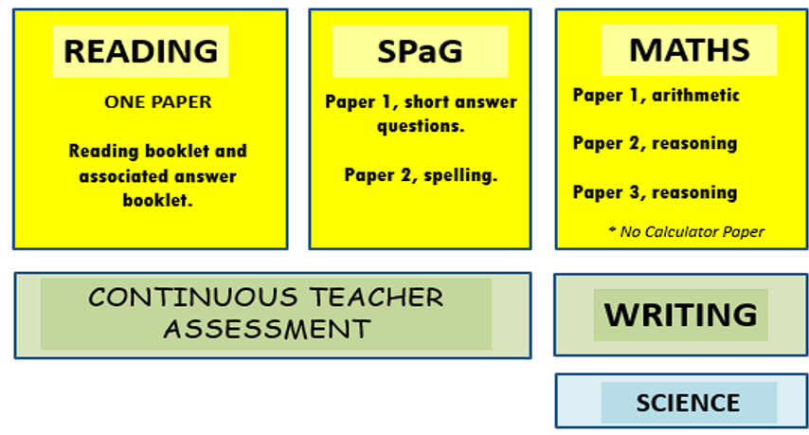
What will be assessed?
The tests all take place in normal school time, under test conditions.
Pupils will not be allowed to talk to each other or communicate in any way during the tests.
The completed papers are sent away to be marked externally.
Results are returned to school in July.
Notes:
SATs are important to give teachers and parents an insight into students’ strengths and areas for development, as they exit Key Stage 2 and enter Key Stage 3. SATs also give teachers the chance to see how students are performing compared to their peers in the same school and across the country.
Some secondary schools may use Year 6 SATs results (alongside Year 7 exams) as part of their decision process to group students into sets or streams. The best way for your child to enter Year 7 fully confident in their learning journey is to prepare thoroughly for SATs.

Slide 3
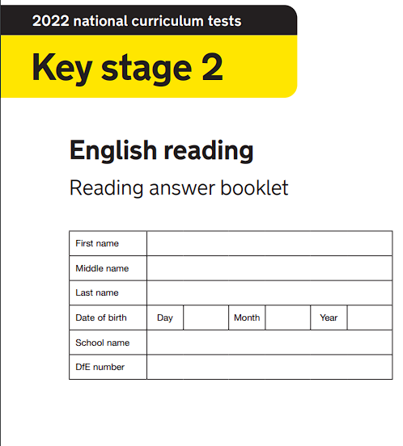
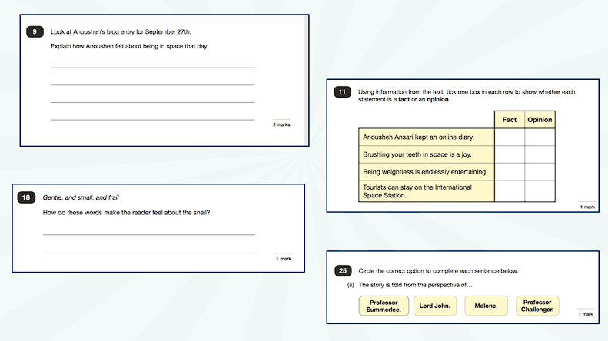
Reading
The reading paper is designed to assess pupils’ knowledge and understanding of:
Vocabulary
Inference (ability to deduce answers using words and phrases as evidence)
Retrieval (finding literal answers from the text)
60 minutes

Slide 4
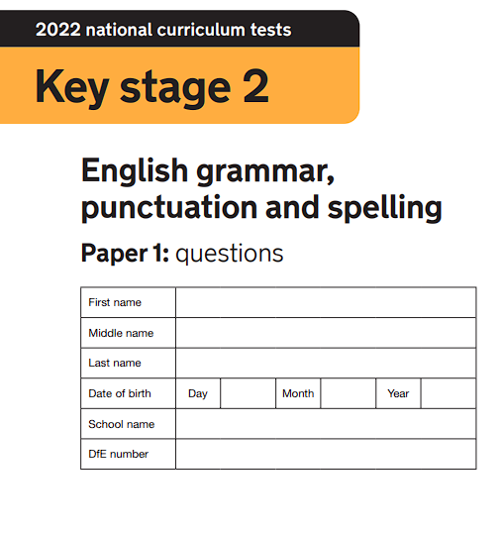
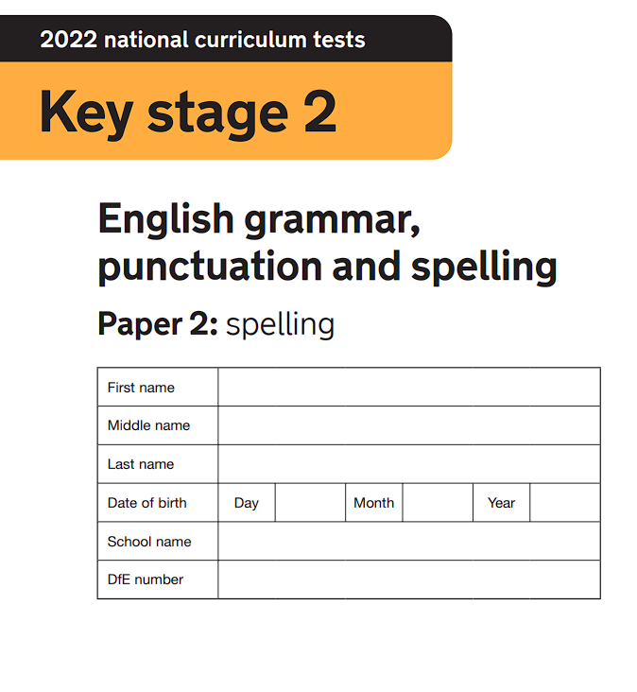
SPaG
spelling, punctuation and grammar
The SPaG paper assesses pupils’ on a variety of areas.
Example questions could include use of standard English, use of suffixes, identification of parts of speech, tenses, basic punctuation including commas and full stops, use of apostrophes.

Slide 5
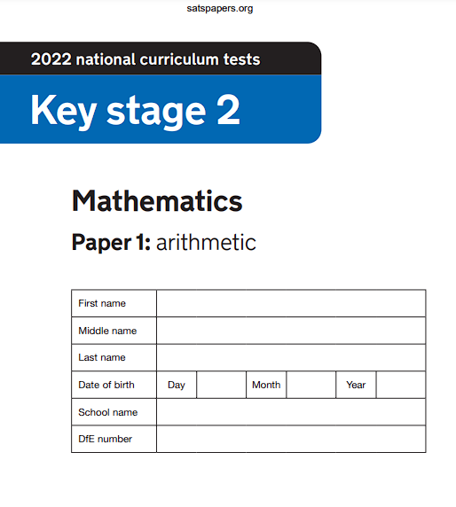
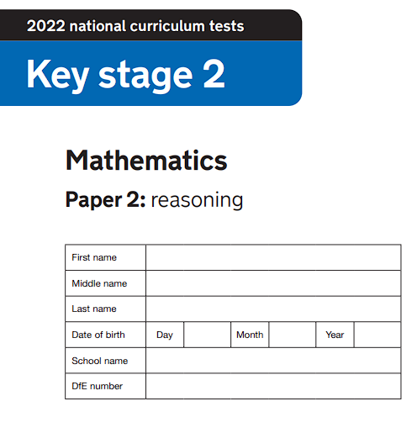
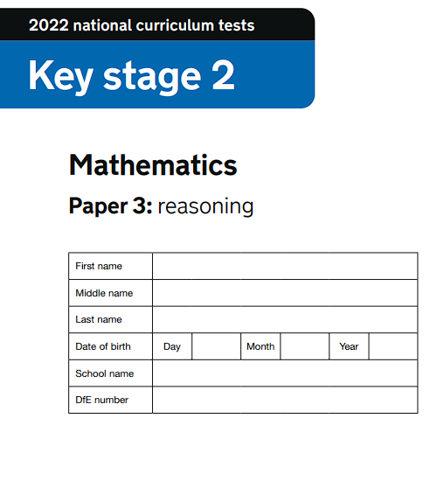
Maths
arithmetic, problem solving and reasoning
The maths paper is designed to assess pupils’ on how confident they are with the range of mathematical operations, their mathematical fluency, their ability to solve problems and their mathematical reasoning. They will be tested on the following eight topics:
Number and place value
Calculations (addition, subtraction, multiplication and division)
Fractions, decimals and percentages
Ratio and proportion
Algebra
Measurement
Geometry (properties of shapes, position and direction)
Statistics

Slide 6
Writing and Science
There are no writing or science SATS test.
A judgement is made in the following ways:
teacher judgement
moderation
Final judgements will be reported to parents at the same time as the other assessment results.

Slide 7
How we are helping your child.
We offer:
classroom support
booster groups (in and out of school)
targeted homework
revision guidance and support
mock SATS tests
Children will be invited to attend a special year 6 breakfast club, so they are in school and settled for their tests.
We do not put pressure on the children as we do not want them to feel worried or pressured about SATS.
All that is asked is that they try their best.

Slide 8
How you can help your child.
Help children to not feel worried or pressured about SATS.
Give lots of praise and encouragement!
Help children to complete homework
Help children to organise a revision timetable.
Help them to have early nights and a healthy diet.
Help your child to have the best possible attendance at school.
A good breakfast on the morning of the SATS.

Slide 9
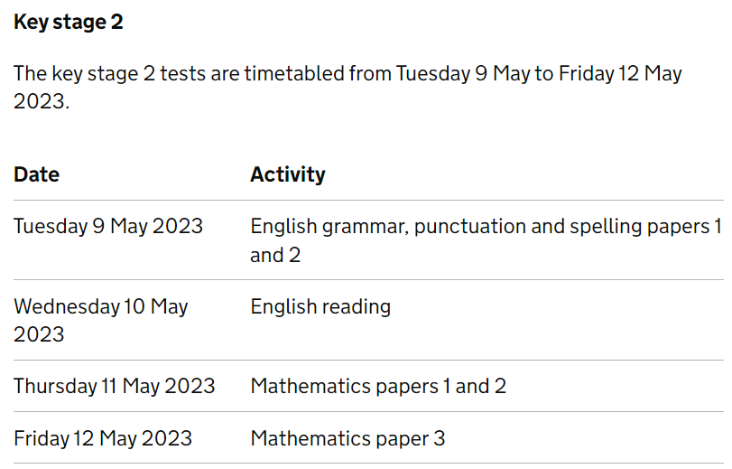
When are the tests?

Slide 10
Reporting Results
Pupil’s progress, as well as their achievement, will be measured and reported on in school performance tables.
Teacher assessments will be passed on to year 7 so the results can be used in planning for KS3 teaching.
You will be given your child’s results when they are available (mid-end of July).
Remember – all children are different.

Slide 11
Scaled Scores
Tests at the end of KS2 will report in scaled scores.
The ‘expected standard’ will always be set to 100.
Raw scores in the test will be converted to scaled scores.
Pupils who score 100 or more will have met ‘expected standard’.
Pupils who score below 100 will not have met the ‘expected standard’.

Slide 12
Finally

