Slide 1
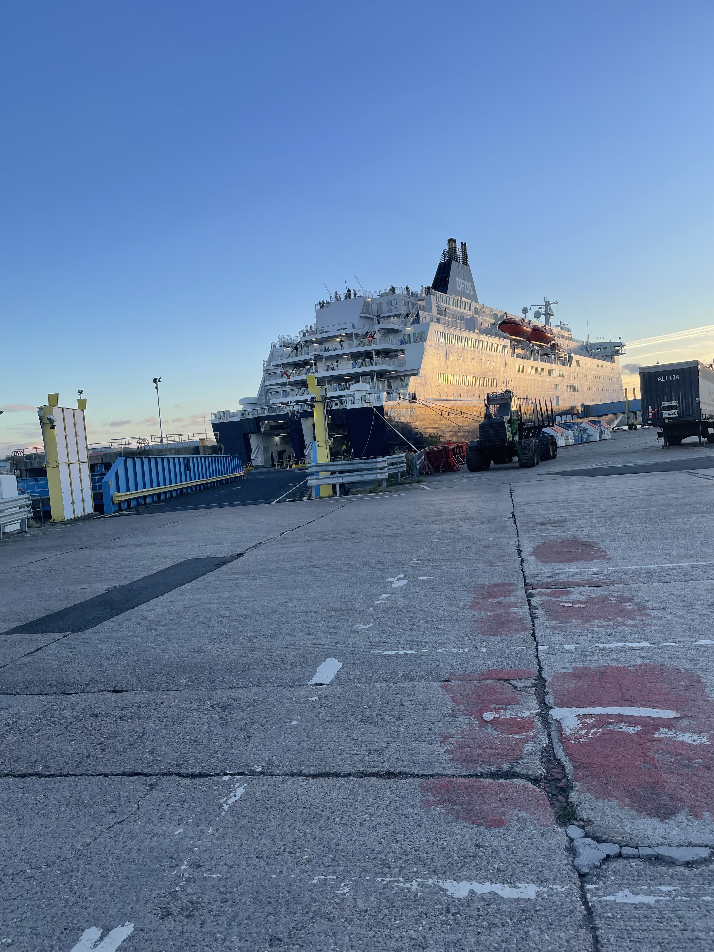
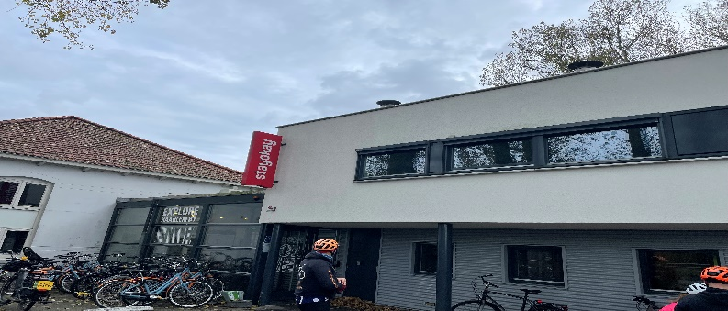
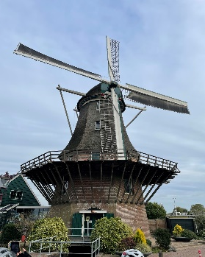
Amsterdam, Holland 2023
Windmills, Beaches, and City Cycling Trip

Slide 2
Supervising adults
John Rutter
Mr MacLeod
Ryan Bailey
Ms Sweet
Mrs Lowes
Richard and Stephen from Bikes4Health

Slide 3
What are the plans ?
Day | Description | Distance | Ascent | Descent | Meals
1 | School to DFDS Ferry Terminal |  |  |  | D
2 | Ijmuiden to Haarlem via Amsterdam City | 59.2km | 102m | 99m | B L D
3 | Haarlem to Ijmuiden via the coast | 51km | 92m | 90m | B L D
4 | DFDS Ferry Terminal to School |  |  |  | B
Meals: B = Breakfast L = Lunch D = Dinner

Slide 4
Travel to Ferry Terminal from Wingrove

Slide 5
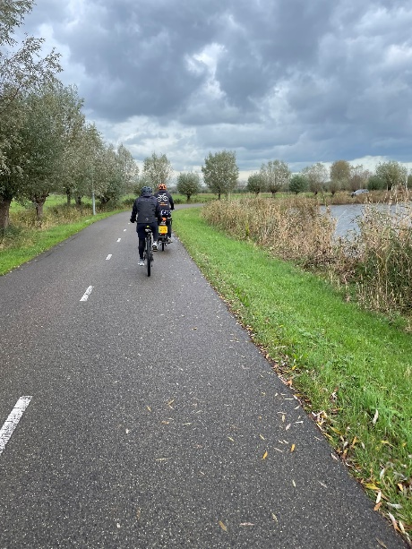
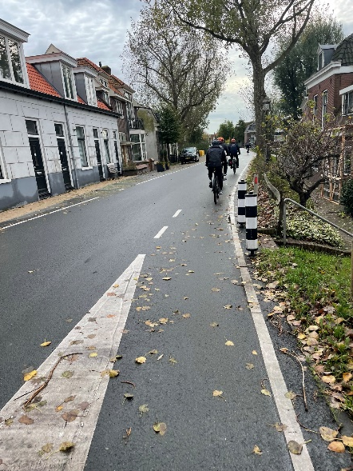
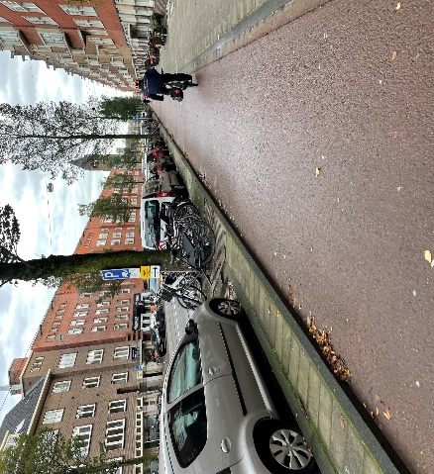
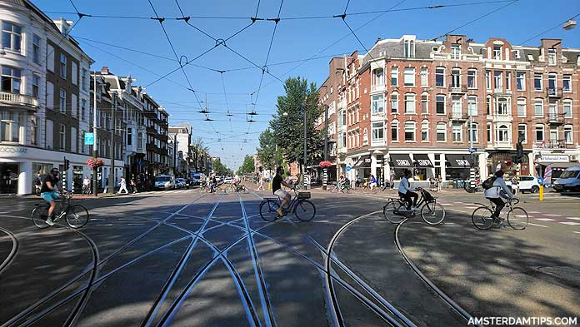
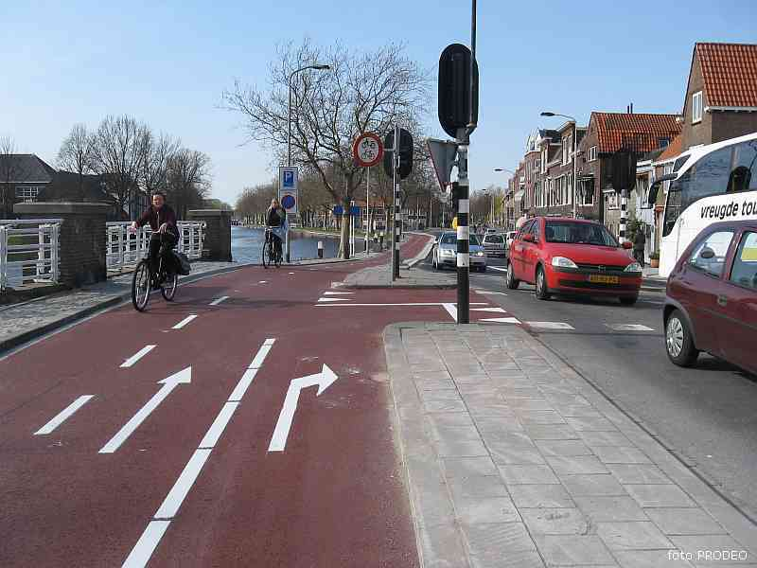
Cycling around Holland

Slide 6
Travel back to Wingrove from Ferry terminal

Slide 7
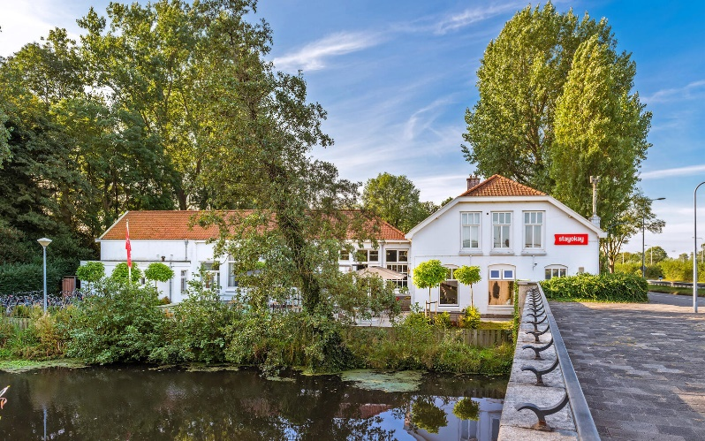
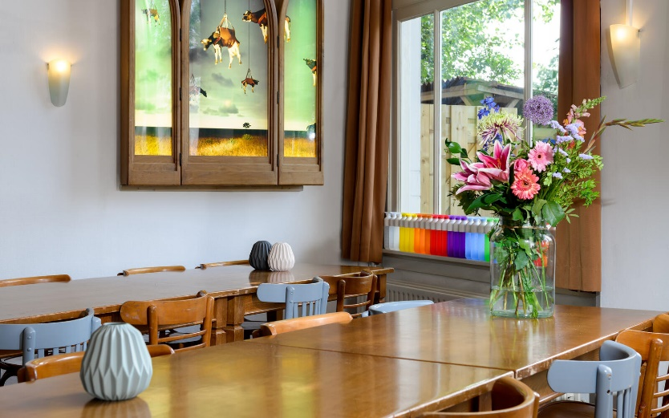
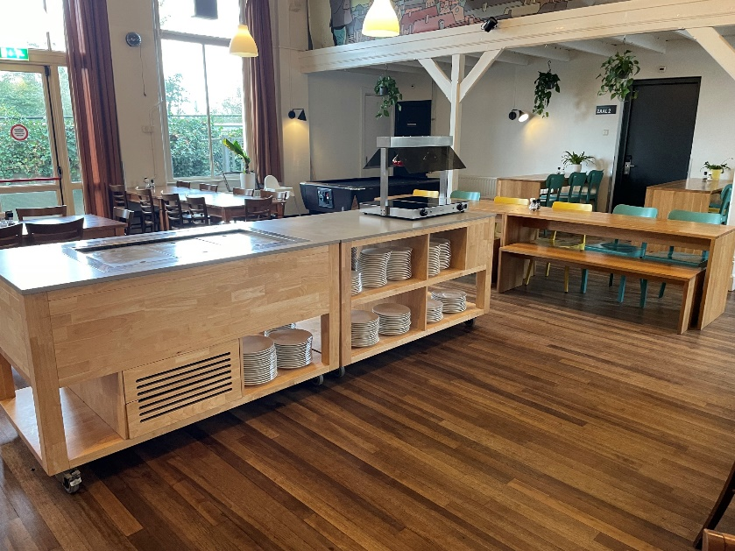
Our Hotel in Haarlem

Slide 8
Kit list
· Spare clothes for 3 nights and 4 days: (tops, bottoms, underwear and footwear) same clothes can be worn multiple times
· School jumper/PE hoodie
· Coat
· Wash kit (toothbrush, toothpaste, shower gel etc.)
· Spare socks x 5 (in case of bad weather)
· Pyjamas
· Towel
· Max 20 Euros spending money (clearly labelled)
· No mobile phones
For the ride
· Suitable footwear to cycle in
· Warm hat (to put in back pack)
· Gloves x2 (in case of bad weather and first pair get wet)
School will provide
· Bike
· Helmet
· Cycle tights
· Cycling jacket
· Warm top
· Water bottle
· Small back pack (to wear when cycling)
Suitcase

Slide 9
Spending money
Maximum of 20 Euros spending money

Slide 10
Do not take!
Electronic devices
Jewellery
Anything valuable

Slide 11
Preparation
During PE lessons
After School clubs
Bike trips

Slide 12
Keeping in touch
Children are not allowed to bring their own mobile phone
Text messages / Travel WhatsApp group set up by school
We will take all photos and videos – Wingrove Twitter page and WhatsApp

Slide 13
What you will need
Passport – with more than 3 months before expiry date
Complete data collection form
Medication (if necessary)
Luggage case/back pack*
*Please note that these will be provided by school

Slide 14
Next Steps
Data Collection Form with all correct details
Commitment to the trip

Slide 15
Any questions
?

