Slide 1












Slide 2

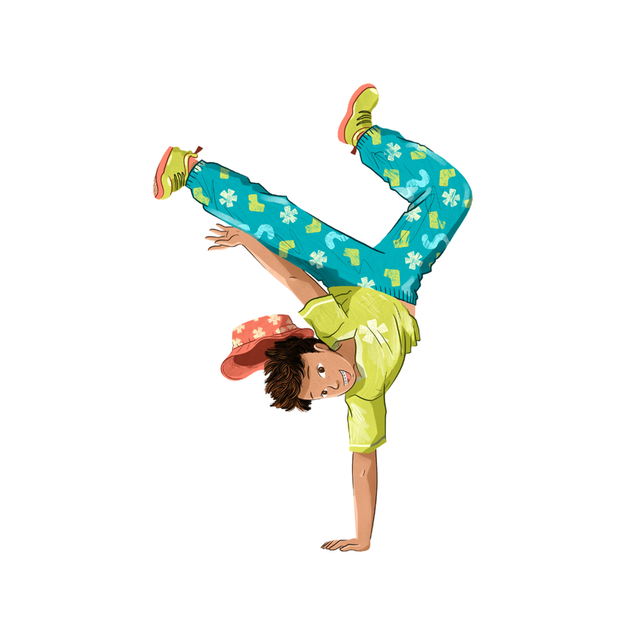

What is the Summer Reading Challenge?
It's your chance to
  read some new and exciting books over the summer
  take part in fun activities
  win prizes!

Slide 3
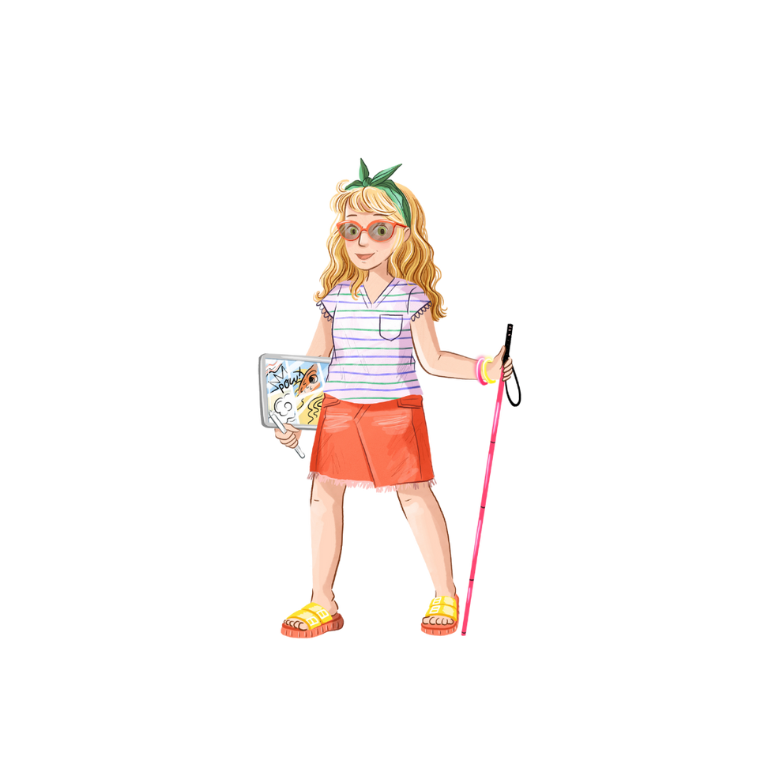

How do I take part?
  Join your local library
  Using your new library card, borrow books and take part in lots of creative activities
  Collect stickers to claim your certificate or enter the prize draw!

Slide 4

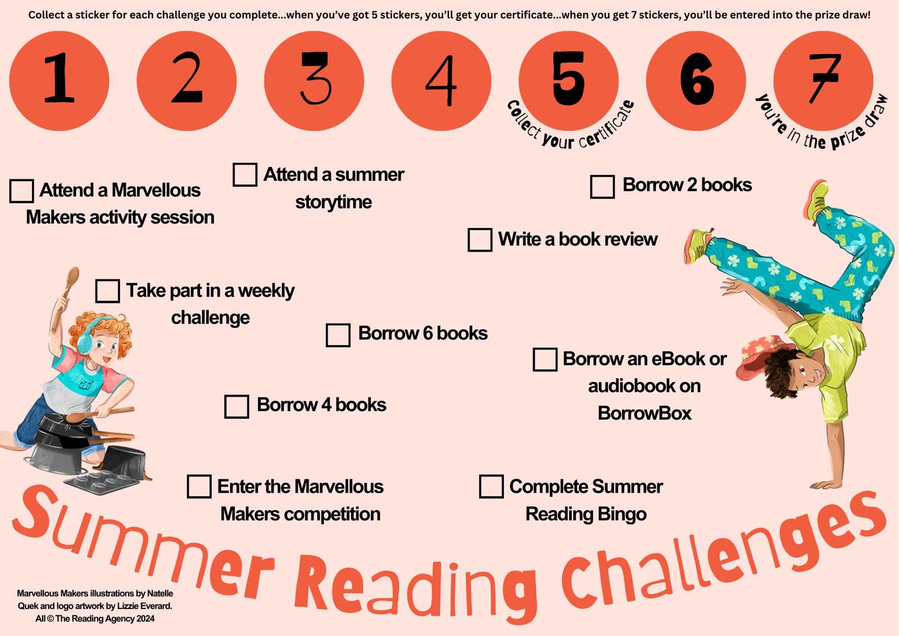


Slide 5
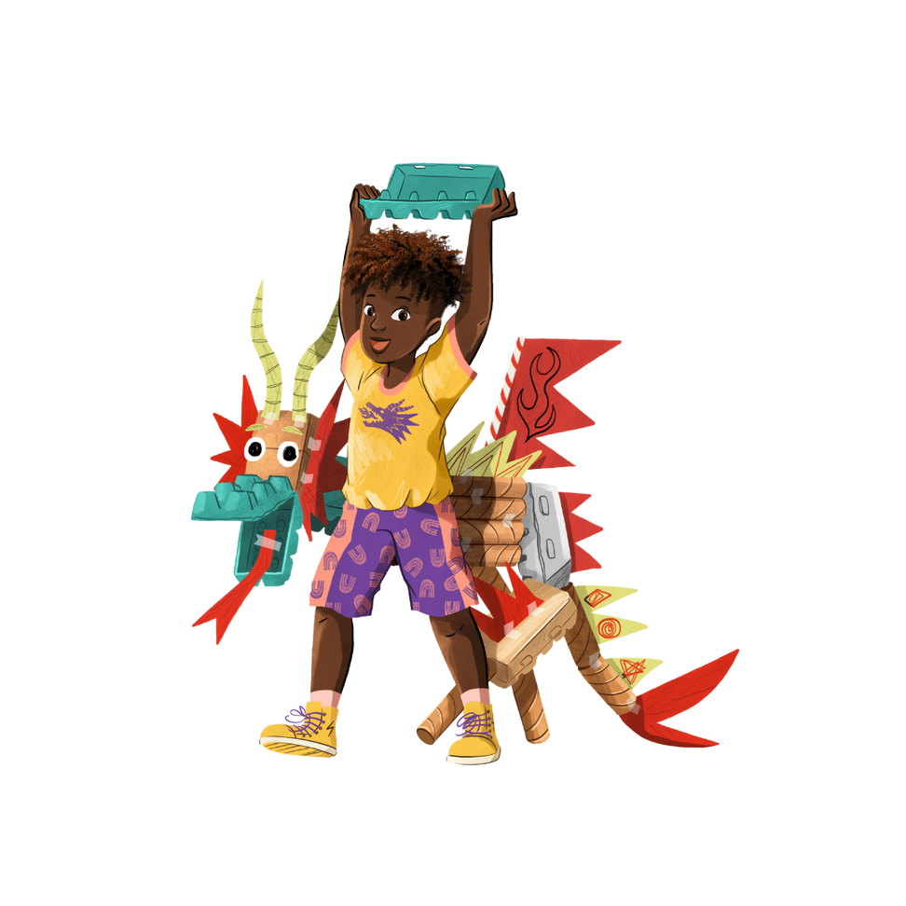
Marvellous Makers!
This year's theme is all about being creative.
Our libraries will have lots of fun, free activities and events such as
  author and illustrator visits
  workshops - learn a new skill!
  crafts - make a friendship bracelet!
  music making & silent discos

Slide 6


Prizes!
  Art sets
  Lego
  Disney on Ice Tickets
School Trophy
For the school with the most people who complete the challenge by collecting 5 stickers

Slide 7
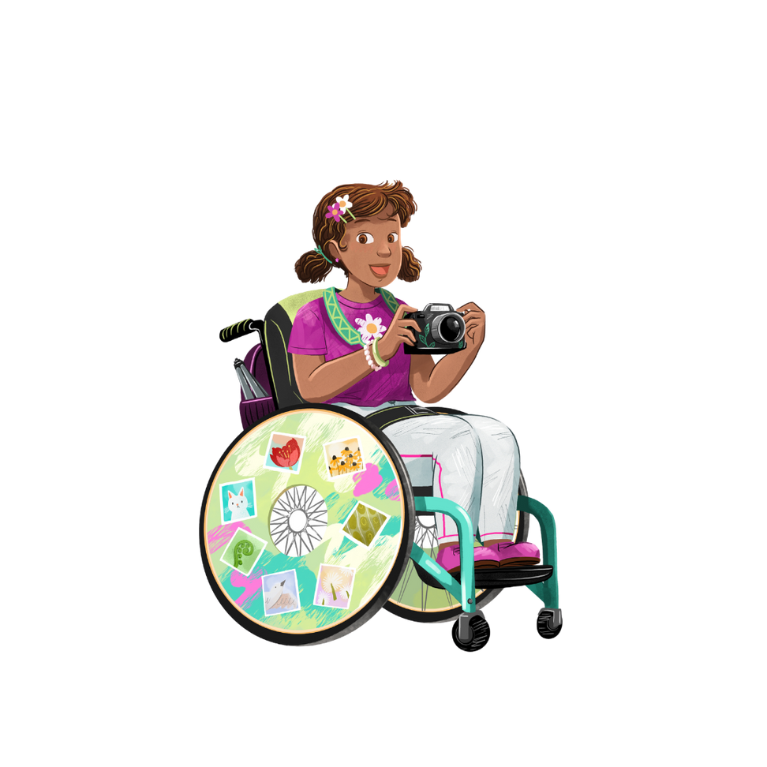


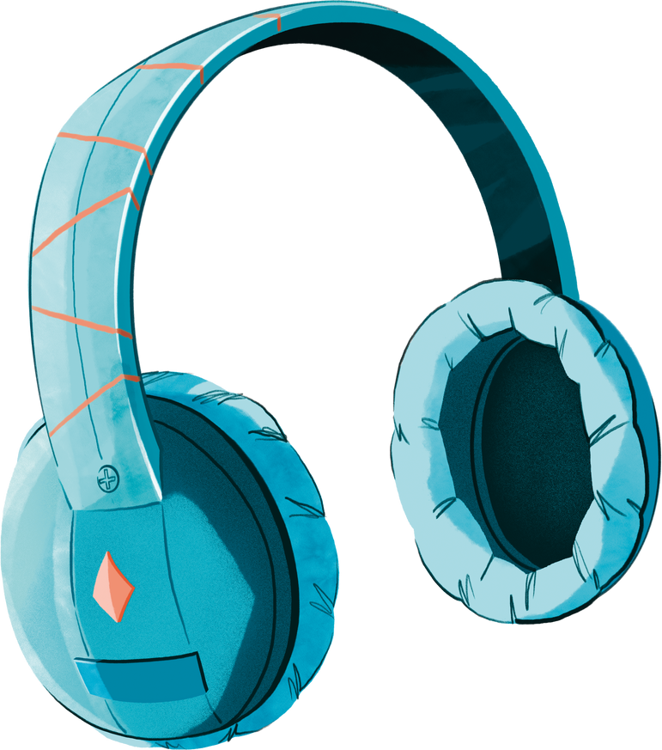
Design Competition
Newcastle through Children's Eyes
Create a story, song, poem, essay or poster celebrating what Newcastle means to you!

